Slide 1

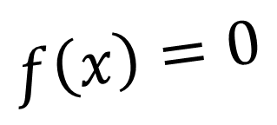
CH2120 Dekker’s Method
$$f\left(x\right)=0$$
Class 19
September 22, 2022

Slide 2
The n^{th} iteration
Origin
Estimation
Modification

Slide 3

The Bisection Method

Slide 4

The Secant Method
2
3
2
1
1

Slide 5

Dekker’s Method
Case 1: s lies between b and R
$$f\left(R\right)<f\left(B\right)$$
B
b
s
R
3
2
S
1
Case 1a: sign(f_{B}) = sign(f_{R})
B
R
S
f_{B}
f_{R}

Slide 6
Dekker’s Method
Case 2: s lies outside b and R
B
s
b
R
S
Case 2a: sign(f_{B}) = sign(f_{R})
B
R
S
f_{B}
f_{R}

